Slide 1
Computer Networks _22CS008
WLAN, Configuration and Wireless Networks
Lecture 27 (Theory)
Prepared By:
Dr. Shveta Bansal
Department of Computer Science and Engineering,
Chitkara University, Punjab

Slide 2
Index
Introduction
Types of networks
WLAN technologies
WLAN standards-802.11
WLAN components
WLAN Configuration

Slide 3
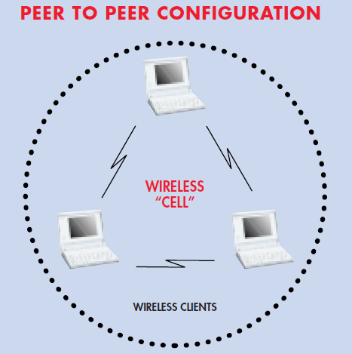
1. Introduction
A Wireless LAN (WLAN) is a type of wireless network that is commonly used in homes, offices, and campus environments for higher data volumes.
WLANs provide high-speed, reliable data communications and are simple to install and do not incur monthly user fees or data transmission charges.
Wireless LANs can be built with either of two topologies: peer-to-peer or access point-based.
In a peer-to-peer topology, client devices within the wireless cell communicate directly to each other as depicted in Figure 1.
An access point is a bridge that connects a wireless client device to the wired network. It uses access points to bridge traffic onto a wired (Ethernet or Token Ring) or wireless backbone.
Figure 1: Peer-Peer WLAN

Slide 4
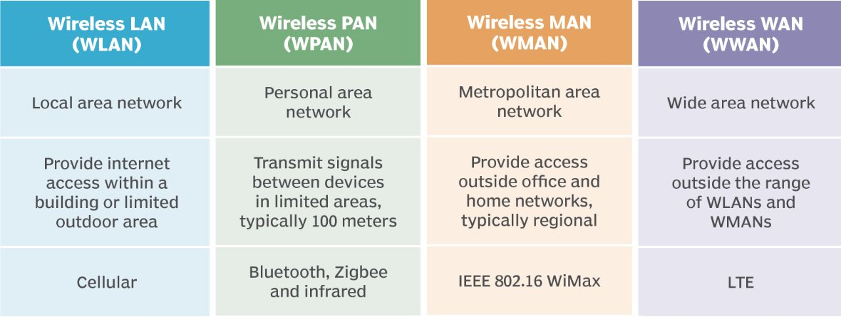
Types of Wireless networks
Table 1: Comparison of Wireless networks

Slide 5
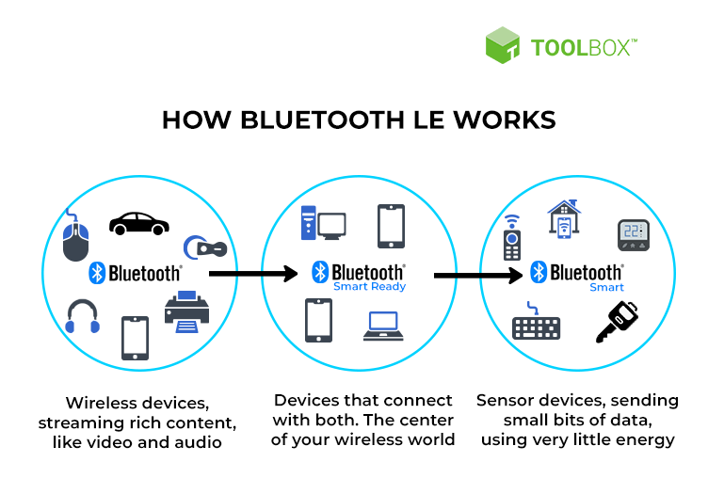
Wireless Technologies
Bluetooth
An IEEE 802.15 WPAN standard that uses a device-pairing process to communicate over distances up to 300 ft. (100m). It can be found in smart home devices, audio connections, automobiles, and other devices that require a short distance connection. There are two types of Bluetooth radios:
Bluetooth Low Energy (BLE) - This supports multiple network technologies including mesh topology to large scale network devices.
Bluetooth Basic Rate/Enhanced Rate (BR/EDR) - This supports point to point topologies and is optimized for audio streaming.
Figure 2: How BLE works

Slide 6
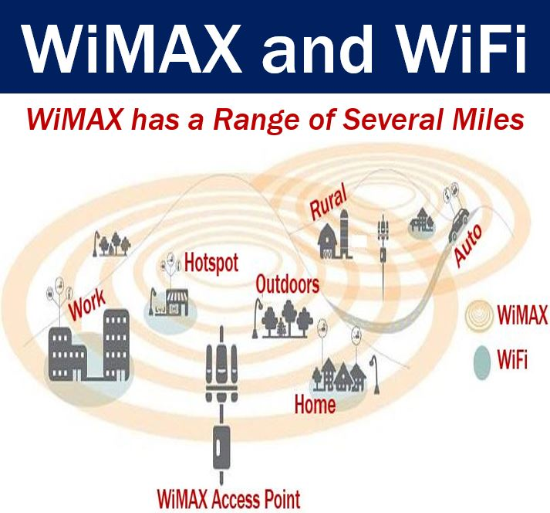
Wireless Technologies
WiMAX (Worldwide Interoperability for Microwave Access)
WiMAX is an alternative to broadband wired internet connections, competing with DSL and cable. It is typically used in areas that are not yet connected to a DSL or cable provider.
It is an IEEE 802.16 WWAN standard that provides high-speed wireless broadband access of up to 30 miles (50 km).
WiMAX operates in a similar way to Wi-Fi, but at higher speeds, over greater distances, and for a greater number of users. It uses a network of WiMAX towers that are similar to cell phone towers.
Figure 3: WiMax and Wifi

Slide 7
Wireless Technologies
Cellular Broadband
Cellular 4G/5G are wireless mobile networks primarily used by cellular phones but can be used in automobiles, tablets, and laptops.
Cellular networks are multi-access networks carrying both data and voice communications. A cell site is created by a cellular tower transmitting signals in a given area. Interconnecting cell sites form the cellular network.
The two types of cellular networks are Global System for Mobile (GSM) and Code Division Multiple Access (CDMA). GSM is internationally recognized, while CDMA is primarily used in the US.
The 4th Generation mobile network (4G) is the current mobile network. 4G delivers speeds that are 10 times the previous 3G networks. The new 5G holds the promise of delivering 100 times faster speeds than 4G and connecting more devices to the network than ever before.
Satellite Broadband
Provides network access to remote sites through the use of a directional satellite dish that is aligned with a specific geostationary Earth orbit satellite.
It is usually more expensive and requires a clear line of sight. Typically, it is used by rural homeowners and businesses where cable and DSL are not available.

Slide 8
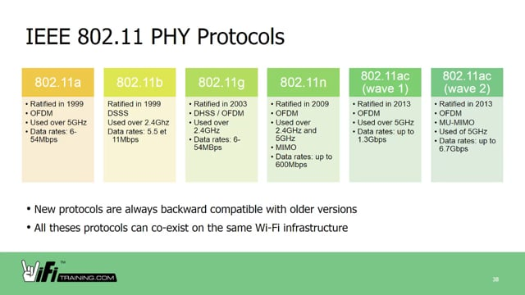
WLAN Standards-802.11
Table 2: 802.11 Standards
802.11ax
latest standard released in 2019 and also known as Wi-Fi 6 or High-Efficiency Wireless (HEW)
provides improved power efficiency, higher data rates, increased capacity, and handles many connected devices
currently operates using 2.4 GHz and 5 GHz but will use 1 GHz and 7 GHz when those frequencies become available

Slide 9
WLAN Components
Wireless NICs
Wireless deployments require a minimum of two devices that have a radio transmitter and a radio receiver tuned to the same radio frequencies:
-End devices with wireless NICs
-A network device, such as a wireless router or wireless AP
To communicate wirelessly, laptops, tablets, smart phones, and even the latest automobiles include integrated wireless NICs that incorporate a radio transmitter/receiver. However, if a device does not have an integrated wireless NIC, then a USB wireless adapter can be used.
Wireless Router
A wireless router is commonly implemented as a small business or residential wireless access device.
Most wireless routers also provide advanced features, such as high-speed access, support for video streaming, IPv6 addressing, quality of service (QoS), configuration utilities, and USB ports to connect printers or portable drives.
Additionally, home users who want to extend their network services can implement Wi-Fi range extenders. A device can connect wirelessly to the extender, which boosts its communications to be repeated to the wireless router.

Slide 10
WLAN Components
Wireless Access Points
While range extenders are easy to set up and configure, the best solution would be to install another wireless access point to provide dedicated wireless access to the user devices. Wireless clients use their wireless NIC to discover nearby APs advertising their SSID. Clients then attempt to associate and authenticate with an AP. After being authenticated, wireless users have access to network resources.
Autonomous APs: These are standalone devices configured using a command line interface or a GUI. Autonomous APs are useful in situations where only a couple of APs are required in the organization. A home router is an example of an autonomous AP because the entire AP configuration resides on the device
Controller-based APs: These devices require no initial configuration and are often called lightweight APs (LAPs). LAPs use the Lightweight Access Point Protocol (LWAPP) to communicate with a WLAN controller (WLC). Controller-based APs are useful in situations where many APs are required in the network. As more APs are added, each AP is automatically configured and managed by the WLC.

Slide 11
WLAN Components
4. Wireless Antennas
Most business class APs require external antennas to make them fully functioning units.
Omnidirectional antennas provide 360-degree coverage and are ideal in houses, open office areas, conference rooms, and outside areas.
Directional antennas focus the radio signal in a given direction. This enhances the signal to and from the AP in the direction the antenna is pointing This provides a stronger signal strength in one direction and reduced signal strength in all other directions. Examples of directional Wi-Fi antennas include Yagi and parabolic dish antennas.
Multiple Input Multiple Output (MIMO) uses multiple antennas to increase available bandwidth for IEEE 802.11n/ac/ax wireless networks. Up to eight transmit and receive antennas can be used to increase throughput.

Slide 12
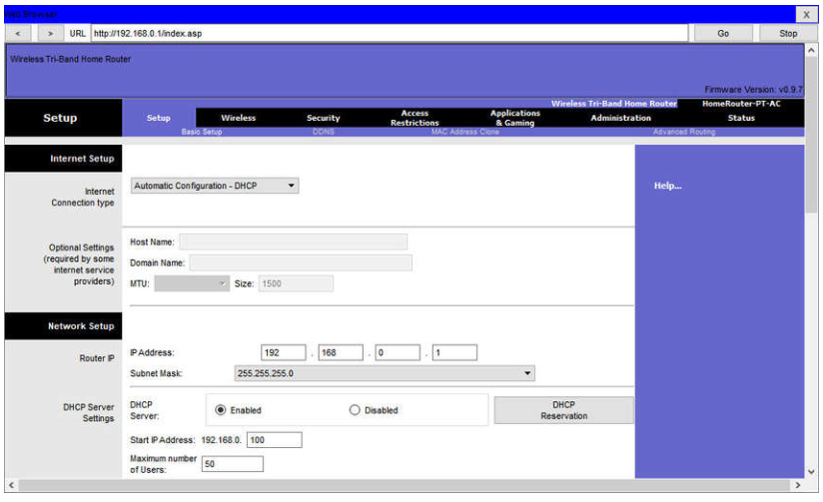
WLAN Configuration
Basic network setup includes the following steps:
Log in to the router from a web browser: After logging in, a GUI opens. The GUI will have tabs or menus to help you navigate to various router configuration tasks. It is often necessary to save the settings changed in one window before proceeding to another window. At this point, it is a best practice to make changes to the default settings.

Slide 13
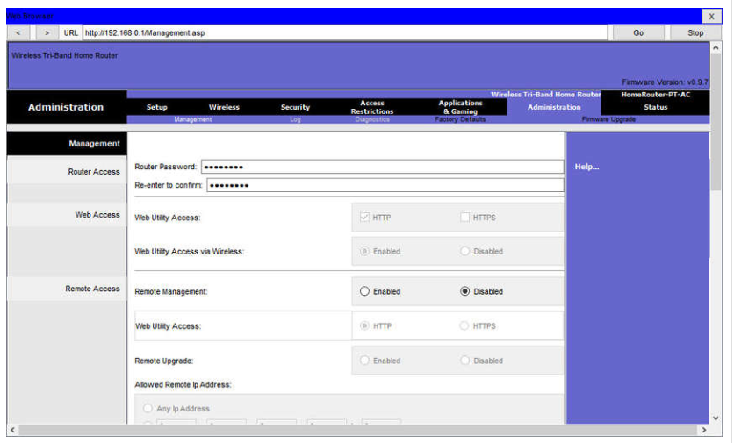
WLAN Configuration
2. Change the default administrative password.
To change the default login password, find the administration portion of the router’s GUI. In this example, the Administration tab was selected. This is where the router password can be changed. On some devices, such as the one in the example, you can only change the password. The username remains admin or whatever the default username is for the router you are configuring.

Slide 14
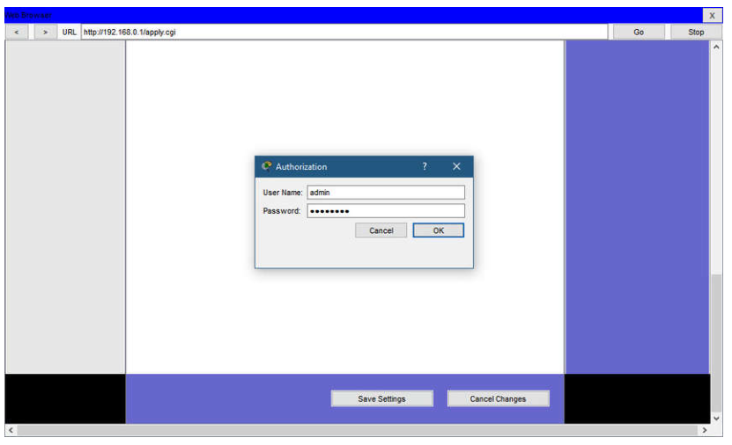
WLAN Configuration
3. Log in with the new administrative password.
After you save the new password, the wireless router will request authorization again. Enter the username and new password.

Slide 15
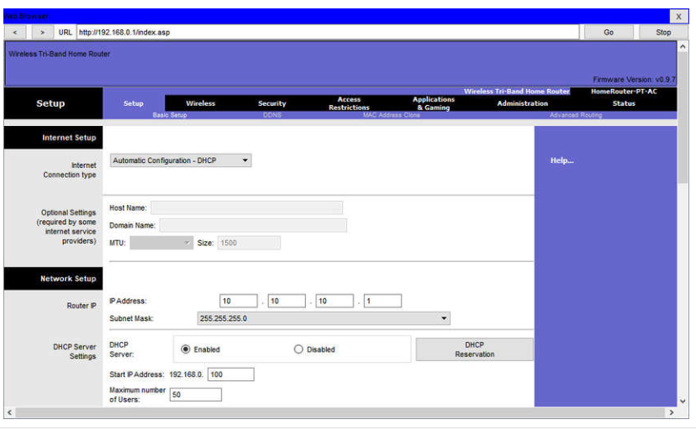
WLAN Configuration
4. Change the default DHCP IPv4 addresses.
Change the default router IPv4 address. It is a best practice to use private IPv4 addressing inside your network. The IPv4 address 10.10.10.1 is used in the example but it could be any private IPv4 address you choose.

Slide 16
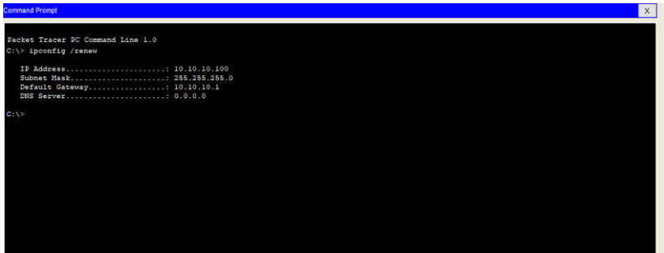
WLAN Configuration
5. Renew the IP address.
When you click save, you will temporarily lose access to the wireless router. Open a command window and renew your IP address with the ipconfig /renew command.

Slide 17
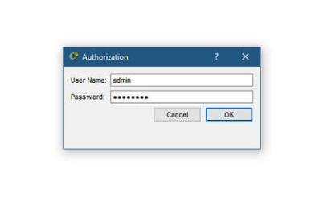
WLAN Configuration
6. Log in to the router with the new IP address.
Enter the router’s new IP address to regain access to the router configuration GUI. You are now ready to continue configuring the router for wireless access.

Slide 18
Practice Questions
Which of the following wireless networks typically uses lower powered transmitters for short ranges?
(a) WPAN (b)WMAN
(c) WLAN (d) WWAN
Which of the following wireless networks are specified in the IEEE 802.11 standards for the 2.4 GHz and 5 GHz radio frequencies?
(a) WPAN (b)WMAN
(c) WLAN (d) WWAN
Which of the following is an IEEE 802.15 WPAN standard that uses a device-pairing process to communicate?
(a) Cellular (b) WiMAX
(c) Wi-Fi (d) Bluetooth
Which of the following is a standalone device, like a home router, where the entire WLAN configuration resides on the device?
(a) Range Extender (b) Autonomous AP
(c) Controller-based AP (d) USB wireless NIC

